Slide 1
HELLO

Slide 3
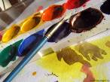
Pronounce the words correctly:
[a:] [ju:] [∫] [t∫]
art you sharpener picture
ask computer bookshelf teacher
answer pupil dictionary question
heart music Russian Literature

Slide 4
Our School

Slide 5
Take….
a school bag

Slide 6
Take…..
a textbook

Slide 7
Take....
a pencil

Slide 8
Take…..
an workbook

Slide 9
Take....
A pen

Slide 10
Take…..
A pencil box

Slide 11
You must take….
a ruler

Slide 12
You must take….
a
rubber

Slide 13
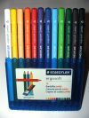
You must take….
Coloured pencils

Slide 14
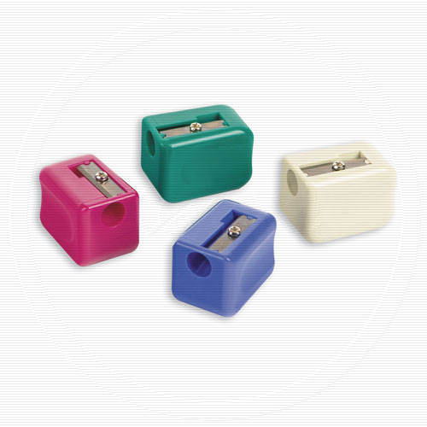
You must take….
a
pencil sharpener

Slide 15
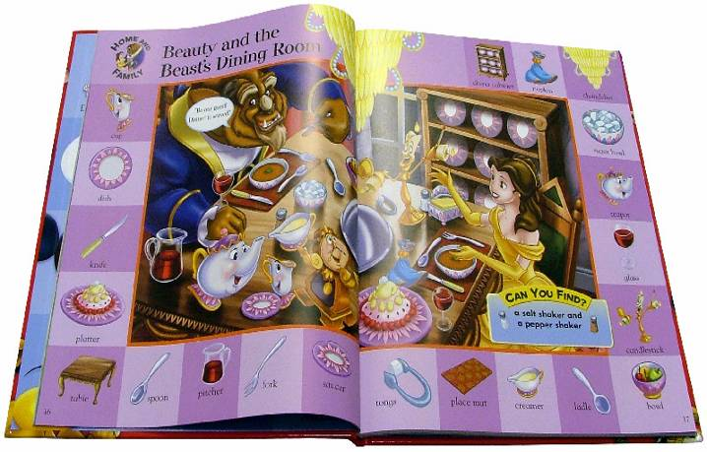
Need – нуждаться
You need –
тебе нужен(нужны)

Slide 16
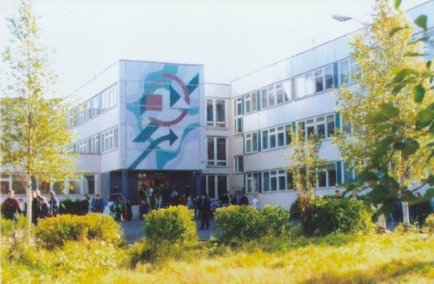
Complete the sentences:
I … to go to school.
My favourite subjects at school are … .
I learn … because … .
I like to … at the lesson of … .
I need … at the lesson of … .
I don’t like … .
I don’t like to … at the lesson of … .
I must … .
I mustn’t … .

Slide 17
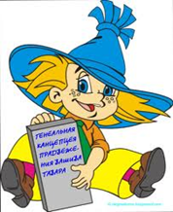
Thank you for your work

